Slide 1
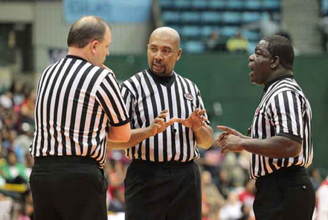
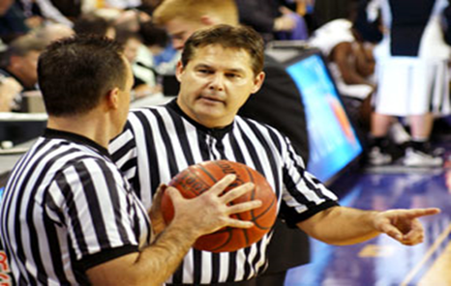
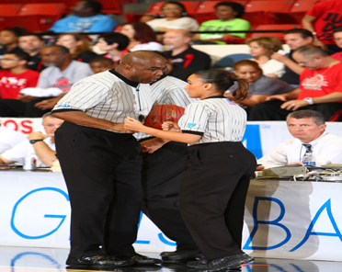
2021-23 NFHS Basketball
Officials UPDATE
Mechanics Changes

Slide 2
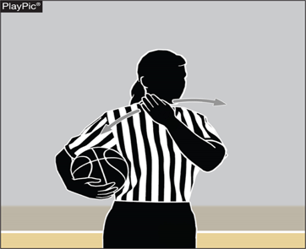
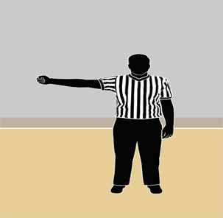
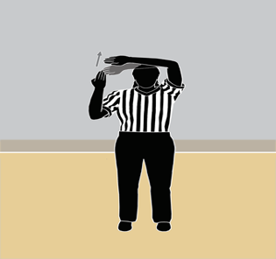
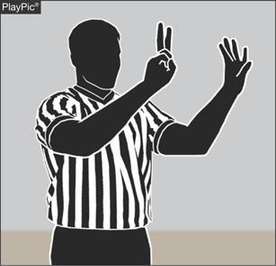
Mechanic changes
2021-23 Basketball Officials Manual Update

Slide 3
2-14 (NEW) SHOT CLOCK
By state association adoption, effective with the 2022-2023 season, member state associations may establish a shot clock in which the team in control shall attempt a try for field goal within 35 seconds after gaining team control.
  ART. 1 This shall be regulated by a visible shot clock.
  ART. 2 The tap or try for field goal shall leave the shooter's hand before the expiration of time and subsequently strike the basket ring or enter the basket before or after the shot clock period has expired.
Notes:
2-14 (NEW)
By state association adoption, effective with the 2022-2023 season, member state associations may establish a shot clock in which the team in control shall attempt a try for field goal within 35 seconds after gaining team control.
ART. 1 This shall be regulated by a visible shot clock.
ART. 2 The tap or try for field goal shall leave the shooter's hand before the expiration of time and subsequently strike the basket ring or enter the basket before or after the shot clock period has expired.

Slide 4
SHOT CLOCK
  Shot clock regulations as printed in the 2021-22 Basketball Rules Book must be followed to be in compliance with the rules.
Notes:
SHOT CLOCK
Shot clock regulations as printed in the 2021-22 Basketball Rules Book must be followed to be in compliance with the rules.

Slide 5
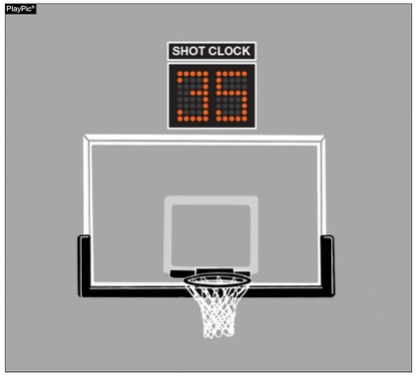
2-14 (NEW) shot clock STATE ADOPTION 2022-23
NFHS permits state association adoption of the shot clock, effective with the 2022-23 season.
Notes:
2-14 (NEW) SHOT CLOCK STATE ADOPTION 2022-23
NFHS permits state association adoption of the shot clock, effective with the 2022-23 season.

Slide 6
3-5-4e (NEW) HEAD COVERINGS
FOR RELIGIOUS REASONS
Head coverings worn for religious reasons shall not be made of abrasive or hard materials; and must fit securely so that they are highly unlikely to come off during play.
NOTE: The State Association shall be notified, after the contest, if there is a concern about a head covering worn for religious reasons.
Notes:
3-5-4e (NEW) HEAD COVERINGS FOR RELIGIOUS REASONS
Head coverings worn for religious reasons shall not be made of abrasive or hard materials; and must fit securely so that they are highly unlikely to come off during play.
NOTE: The State Association shall be notified, after the contest, if there is a concern about a head covering worn for religious reasons.

Slide 7
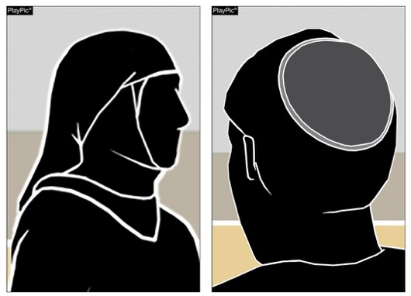
3-5-4e (NEW)
RELIGIOUS HEAD COVERINGS
Players may wear head coverings for religious reasons.
Notes:
3-5-4e (NEW) RELIGIOUS HEAD COVERINGS
Players may wear head coverings for religious reasons.

Slide 8
3-5-4f EXCEPTION HEAD COVERING FOR MEDICAL OR COSMETIC REASONS
Head decorations and headwear, except those specified above, are prohibited.
EXCEPTION: State associations may on an individual basis permit a player to participate while wearing a head covering if it meets the following criteria: For medical or cosmetic reasons - In the event a participant is required by a licensed medical physician to cover the head with a covering or wrap, the physician’s statement is required before the state association can approve a covering or wrap which is not abrasive, hard or dangerous to any other player and which is attached in such a way that it is highly unlikely to come off during play.
Notes:
3-5-4f EXCEPTION HEAD COVERINGS FOR MEDICAL OR COSMETIC REASONS
Head decorations and headwear, except those specified above, are prohibited.
EXCEPTION: State associations may on an individual basis permit a player to participate while wearing a head covering if it meets the following criteria: For medical or cosmetic reasons - In the event a participant is required by a licensed medical physician to cover the head with a covering or wrap, the physician’s statement is required before the state association can approve a covering or wrap which is not abrasive, hard or dangerous to any other player and which is attached in such a way that it is highly unlikely to come off during play.

Slide 9
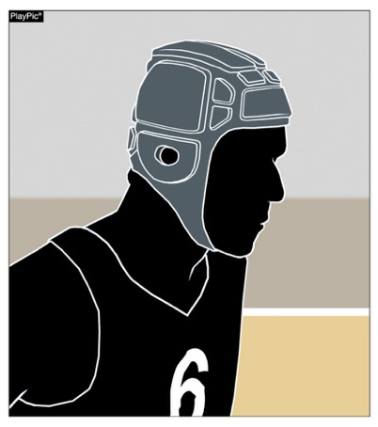
3-5-4f Head coverings worn for medical or cosmetic reasons
A player who needs to wear a head covering for medical or cosmetic reasons is still required to have a letter of permission from the state association.
Notes:
3-5-4f HEAD COVERINGS WORN FOR MEDICAL OR COSMETIC REASONS
A player who needs to wear a head covering for medical or cosmetic reasons is still required to have a letter of permission from the state association.

Slide 10
The MANUAL- Part 3 - SIGNALS 36 & 37
Eliminate signal #37 (Team Control Foul)
Maintain use of signal #36 for Player Control and Team Control Foul
  Preceded by stop clock (Signal 4). The same hand used to stop the clock is placed at the back of the head (Signal 36). The directional signal (Signal 6) shall be given and then indicate the ensuing throw in spot (Signal 7).
  A common foul committed by a player while that player is in control of the ball or by an airborne shooter.
  A common foul committed by a member of the team that has control.
Notes:
The MANUAL- Part 3 - SIGNALS 36 & 37
Eliminate signal #37 (Team Control Foul)
Maintain use of signal #36 for Player Control and Team Control Foul
Preceded by stop clock (Signal 4). The same hand used to stop the clock is placed at the back of the head (Signal 36). The directional signal (Signal 6) shall be given and then indicate the ensuing throw in spot (Signal 7).
A common foul committed by a player while that player is in control of the ball or by an airborne shooter.
A common foul committed by a member of the team that has control.

Slide 11
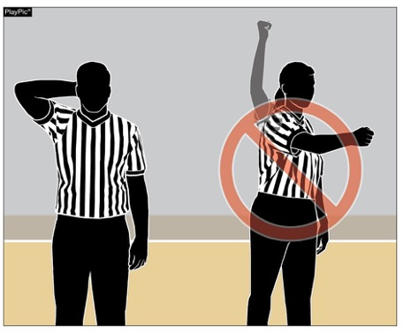
ELIMINATION OF TEAM CONTROL SIGNAL
The player-control foul signal (hand behind the head) will be used to indicate a player-control foul as well as a team-control foul. The punch signal used in the past to indicate a team-control foul was confusing and often used inappropriately.
Notes:
ELIMINATION OF TEAM CONTROL SIGNAL
The player-control foul signal (hand behind the head) will be used to indicate a player-control foul as well as a team-control foul. The punch signal used in the past to indicate a team-control foul was confusing and often used inappropriately.

Slide 12
NFHS Basketball information
2021-23
Notes:
2021-22
NFHS BASKETBALL POINTS OF EMPHASIS

Slide 13

Q-collar
The FDA has authorized marketing of a new device intended to be worn around the neck of athletes aged 13 years and older during sports activities to aid in the protection of the brain from the potential effects associated with repetitive sub-concussive head impacts. The non-invasive device is called the Q-Collar.
From a medical perspective, the NFHS SMAC consents to this device being worn by interscholastic athletes.
The respective NFHS Rules Committees will determine
if the Q-Collar will be permissible based on sport-by-sport risk assessments. Basketball does not have a rule that
prohibits the wearing of the Q-Collar during competition, therefore, it is permissible to wear during competition.
Notes:
Q-COLLAR
The FDA has authorized marketing of a new device intended to be worn around the neck of athletes aged 13 years and older during sports activities to aid in the protection of the brain from the potential effects associated with repetitive sub-concussive head impacts. The non-invasive device is called the Q-Collar.
From a medical perspective, the NFHS SMAC consents to this device being worn by interscholastic athletes.
The respective NFHS Rules Committees will determine if the Q-Collar will be permissible based on sport-by-sport
risk assessments. Basketball does not have a rule that prohibits the wearing of the Q-Collar during competition, therefore, it is permissible to wear during
competition.

Slide 14

VISITING team jerseys gray color spectrum chart
Effective with the beginning of the 2021 Basketball Season, the color gray and/or any other light colors being used for an away jersey, must meet the 70% shading of the main color being used in the jersey in order for it to clearly contrast with white.
100% 90% 80% 70% 60% 50% 40% 30% 20% 10% 0%
Notes:
VISITING TEAM JERSEYS – GRAY COLOR SPECTRUM CHART
Effective with the beginning of the 2021 Basketball Season, the color gray and/or any other light colors being used for an away jersey, must meet the 70% shading of the main color being used in the jersey in order for it to clearly contrast with white.

Slide 15
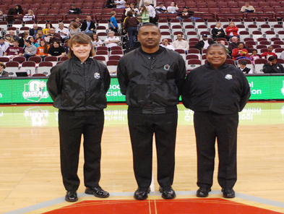
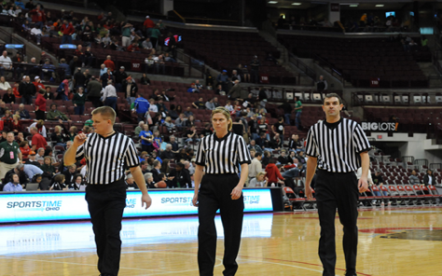
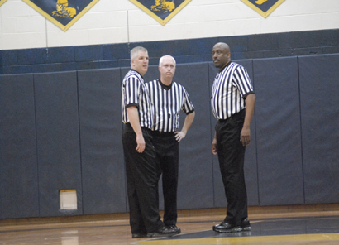
Three-person mechanics
2021-22 Basketball Officials Manual

Slide 16
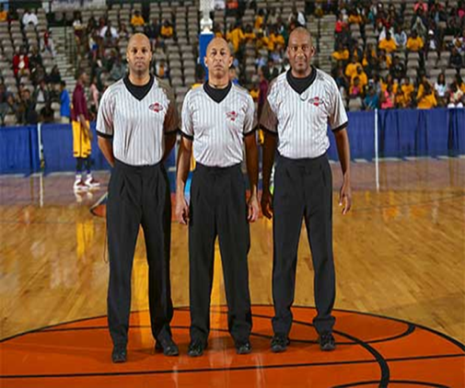
Presentation topics
Part 1 – Officiating Principles
Part 2 – Terminology
Part 3 – Signals
Part 4 – Game Procedures for a
Crew of Two Officials
Part 5 – Game Procedures for a
Crew of Three Officials
Notes:
PRESENTATIONS TOPICS
Part 1 – Officiating Principles
Part 2 – Terminology
Part 3 – Signals
Part 4 – Game Procedures for a
Crew of Two Officials
Part 5 – Game Procedures for a
Crew of Three Officials

Slide 17
terminology
Ball Side: The location of the ball in the normal frontcourt offensive alignment of a team. In dividing the court down the middle, (using the basket as a center point), end line to end line. The side of the court where the ball is located is ball side.
Bump and Run: A technique when one official “bumps” another official out of his/her current position and the vacating official “runs” down into a new position.
Center Official: The outside official who is in the off-ball position, midway between a step below the free-throw line extended and the top of the circle. The Center official may be table side or opposite side.
Notes:
TERMINOLOGY
Ball Side: The location of the ball in the normal frontcourt offensive alignment of a team. In dividing the court down the middle, (using the basket as a center point), end line to end line. The side of the court where the ball is located is ball side.
Bump and Run: A technique when one official “bumps” another official out of his/her current position and the vacating official “runs” down into a new position.
Center Official: The outside official who is in the off-ball position, midway between a step below the free-throw line extended and the top of the circle. The Center official may be table side or opposite side.

Slide 18
terminology
Close Down: Movement of an official (a step or two) related to movement of the ball. The Trail and Center close down toward the end line; the Lead closes down toward the nearest lane line extended.
Lead Official: The official positioned along and off the end line. The Lead official may be table side or opposite the table, but will be on the same side of the court as the Trail.
Move to Improve: A technique that means to “move your feet” in order to “improve your angle” on the play. Helps to eliminate being “straight-lined.”
Notes:
TERMINOLOGY
Close Down: Movement of an official (a step or two) related to movement of the ball. The Trail and Center close down toward the end line; the Lead closes down toward the nearest lane line extended.
Lead Official: The official positioned along and off the end line. The Lead official may be table side or opposite the table, but will be on the same side of the court as the Trail.
Move to Improve: A technique that means to “move your feet” in order to “improve your angle” on the play. Helps to eliminate being “straight-lined.”

Slide 19
terminology
Opposite Side: The side of court opposite the table side.
Primary Coverage Area (PCA): Area of responsibility for each official. PCA is determined by ball location.
Rotation: A live-ball situation, whereby the location of the ball keys a change in coverage for the officials. This is implemented when the Lead official moves to ball side dictating a change of position by the Center and Trail officials. The Lead should not rotate until all three officials are in the frontcourt.
Notes:
TERMINOLOGY
Opposite Side: The side of court opposite the table side.
Primary Coverage Area (PCA): Area of responsibility for each official. PCA is determined by ball location.
Rotation: A live-ball situation, whereby the location of the ball keys a change in coverage for the officials. This is implemented when the Lead official moves to ball side dictating a change of position by the Center and Trail officials. The Lead should not rotate until all three officials are in the frontcourt.

Slide 20
terminology
Straight-Line: Refers to a situation that occurs when an official allows his/her vision to be obstructed by a player or players; having to look through a player instead of in between players. When a straight-line occurs, the official is not able to accurately see playing action. The situation is also known as getting “stacked.”
Strong Side: Side of the court determined by the location of Lead official.
Notes:
TERMINOLOGY
Straight-Line: Refers to a situation that occurs when an official allows his/her vision to be obstructed by a player or players; having to look through a player instead of in between players. When a straight-line occurs, the official is not able to accurately see playing action. The situation is also known as getting “stacked.”
Strong Side: Side of the court determined by the location of Lead official.

Slide 21
terminology
Switch: A dead-ball situation created by an official who calls a violation or foul. After a violation is called or a foul is reported to the table, there may be a change in position of the officials. The switch will normally involve the calling official moving to a new position on the court.
Table Side: The side of the court where the scorer’s and timer’s table is located.
Trail Official: The outside official positioned nearest the division line, approximately 28 feet from the end line (near the top of the three-point arc). The Trail official may be table side or opposite side, but will be on the same side of the court as the Lead.
Notes:
TERMINOLOGY
Switch: A dead-ball situation created by an official who calls a violation or foul. After a violation is called or a foul is reported to the table, there may be a change in position of the officials. The switch will normally involve the calling official moving to a new position on the court.
Table Side: The side of the court where the scorer’s and timer’s table is located.
Trail Official: The outside official positioned nearest the division line, approximately 28 feet from the end line (near the top of the three-point arc). The Trail official may be table side or opposite side, but will be on the same side of the court as the Lead.

Slide 22
terminology
Weak Side: The side of the court opposite the Lead official; the Center’s side of the court.
Wide Triangle: All three officials forming the geometric shape of a wide triangle; keeping all players and activity within the triangle.
Notes:
TERMINOLOGY
Weak Side: The side of the court opposite the Lead official; the Center’s side of the court.
Wide Triangle: All three officials forming the geometric shape of a wide triangle; keeping all players and activity within the triangle.

Slide 23
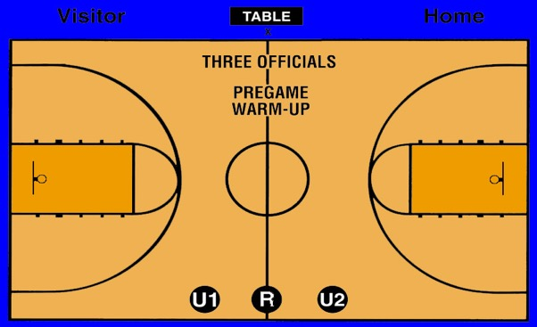
Pregame Positions
U1 observes home team warm-up
U2 observes visiting team warm-up
Notes:
PREGAME POSITIONS
U1 observes home team warm-up
U2 observes visiting team warm-up

Slide 24
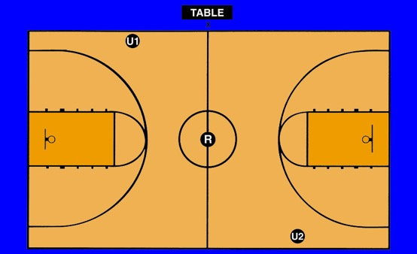
Jump Ball
U1 chops clock – watches jumpers
U2 watches eight non-jumpers
U1 & U2 mindful of quick 3-pt attempt and over/back
Notes:
Jump Ball:
Referee may designate best tosser for opening and overtime jump balls.
U1 chops clock – watches jumpers
U2 watches eight non-jumpers
U1 & U2 mindful of quick 3-pt attempt and over/back

Slide 25
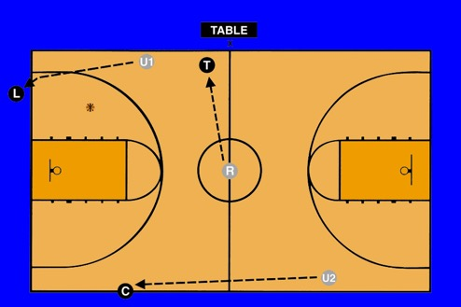
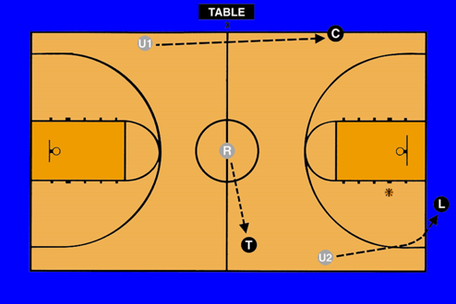
Jump ball
Ball goes left
Ball goes right
R (tossing official) always goes into T position
Notes:
Jump Ball:
R (tossing official) always goes into T position

Slide 26
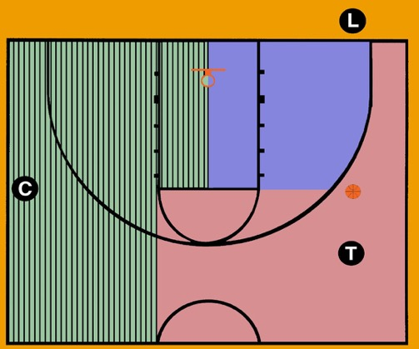
Primary Coverage Areas
Both C and T should close down on shots
Notes:
Primary Coverage Areas:
A. The Trail official has primary responsibility for the area above the free throw line extended to the far lane line extended and outside the three-point arc to the end line.
B. The Center official has primary responsibility for the area from the near lane line extended to the near sideline and the near half of the key area.
C. The Lead official has primary responsibility for the near half of the key area and inside the arc below the free throw line extended.
D. Both C and T should close down on shots.

Slide 27
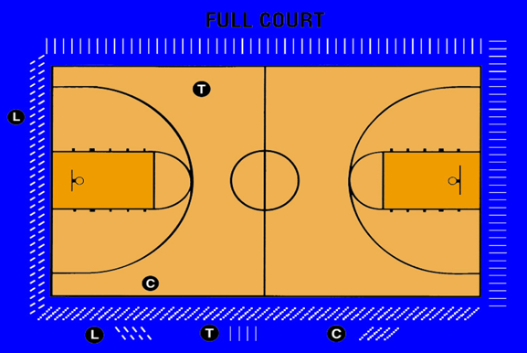
Line coverage
L has entire end line
C has closest sideline
T has closest sideline, division line, and far end line
Call only your line
Notes:
LINE COVERAGE
L has entire end line
C has closest sideline
T has closest sideline, division line, and far end line
Call only your line

Slide 28
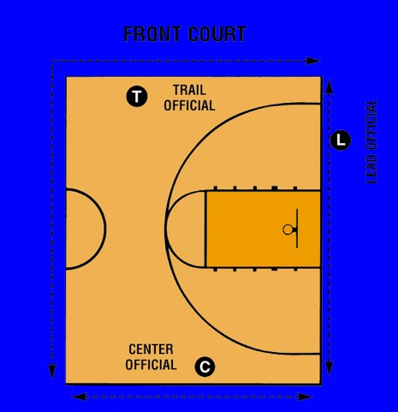
Inbounds Coverage
Notes:
Front Court: INBOUNDS COVERAGE

Slide 29
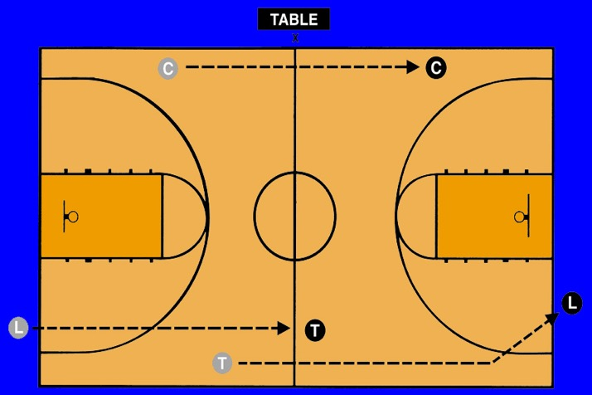
Coverage in Transition
Notes:
Coverage in Transition:
A. Trail becomes new Lead.
B. Center remains Center.
C. Lead becomes new Trail.

Slide 30
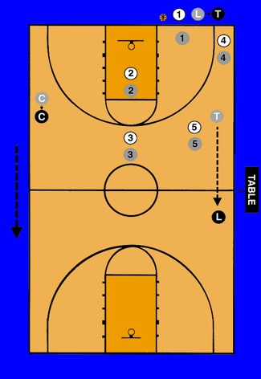
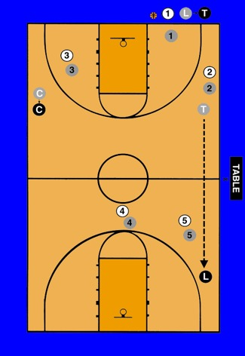
Press Coverage
C stays in backcourt
L should have deepest player in front and boxed-in
Notes:
Press Coverage:
C stays in backcourt
L should have deepest player in front and boxed-in

Slide 31
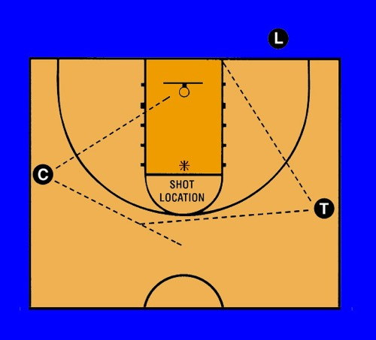
Shot & Rebound Coverage
L should not be positioned within lane lines
Both C and T should close down on shots
C is primarily responsible for weak side rebounding
Notes:
SHOT & REBOUND COVERAGE
L should not be positioned within lane lines
Both C and T should close down on shots
C is primarily responsible for weak side rebounding

Slide 32
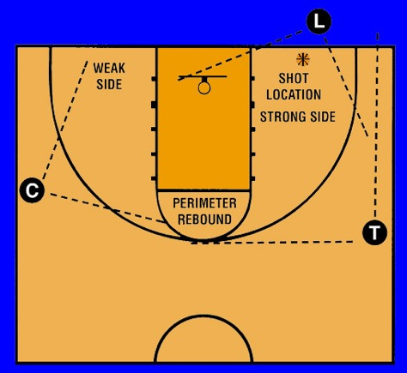
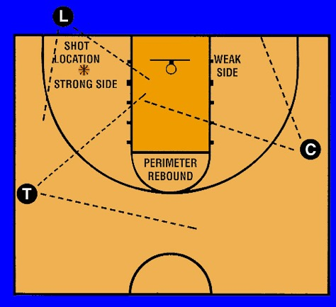
Shot & Rebound Coverage
Notes:
Shot and Rebound Coverage

Slide 33
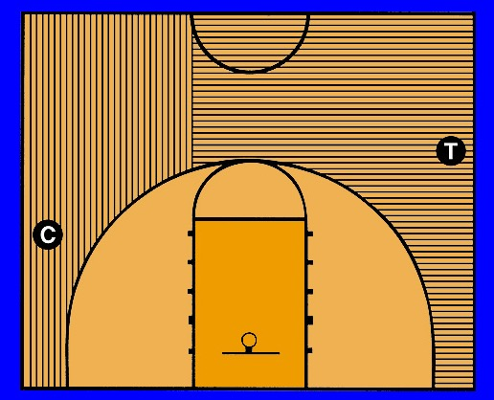
Three-Point Shot Coverage
If both C and T indicate the 3-pt attempt, T referees defense on shooter and stays with shot; C releases and covers rebounding
C/T should mirror the other official’s “good” signal
Notes:
Three-Point Shot Coverage:
If both C and T indicate the 3-pt attempt, T referees defense on shooter and stays with shot; C releases and covers rebounding
C/T should mirror the other official’s “good” signal
L does not have 3-pt attempt responsibilities in a front court offense, but may need to offer assistance on fast break.

Slide 34
Rotations
Rotations should be thoroughly discussed at the pregame conference.
Ball location keys the need for a rotation.
The T or C can facilitate a rotation, but ONLY the L initiates a rotation.
A rotation should only take place when all three officials are in the frontcourt.
A rotation begins when L moves laterally and penetrates the key area.
Notes:
Rotations:
- Rotations should be thoroughly discussed at the pregame conference.
- Ball location keys the need for a rotation.
- The T or C can facilitate a rotation, but ONLY the L initiates a rotation.
- A rotation should only take place when all three officials are in the frontcourt.
- A rotation begins when L moves laterally and penetrates the key area.

Slide 35
Rotations
Rotation is not complete until L passes beyond far lane-line extended.
L must officiate play in the post – even while moving across the lane.
If the L begins to rotate and ball is quickly reversed, or a quick shot taken – L does not have to complete rotation.
There should rarely be two T’s – there may be two C’s for brief periods of time.
Notes:
Rotations:
- Rotation is not complete until L passes beyond far lane-line extended.
- L must officiate play in the post – even while moving across the lane.
- If the L begins to rotate and ball is quickly reversed or a quick shot taken – L does not have to complete rotation.
- There should rarely be two T’s – there may be two C’s for brief periods of time.

Slide 36
Rotations
If a trap occurs near the division line on C’s side of court, C moves higher to officiate that play and L should initiate a rotation.
If L does not rotate – C should go back to a normal C position when play permits.
Remember, only the L initiates a rotation! The C only facilitates the rotation in this case.
Notes:
Rotations:
- If a trap occurs near the division line on C’s side of court, C moves higher to officiate that play and L should initiate a rotation.
- If L does not rotate – C should go back to a normal C position when play permits.
- Remember, only the L initiates a rotation! The C only facilitates the rotation in this case.

Slide 37
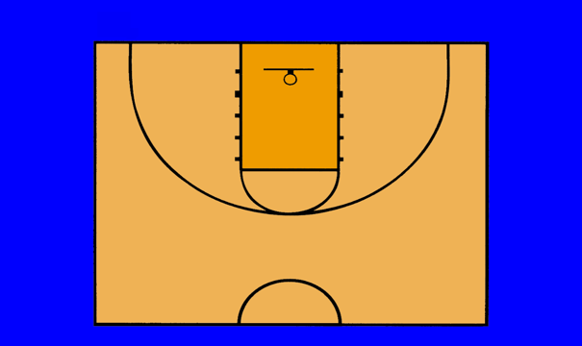




Rotation Sequence
L goes to ball-side, T closes down, C completes rotation (last to rotate)
Notes:
Rotation Sequence:
NOTE: This slide has animation with the diagram and will start on your mouse click; it will proceed automatically. When it stops, just click your mouse again to start up the movement again.
L goes to ball-side, T closes down, C completes rotation (last to rotate)

Slide 38
Transition After Rotation
All officials must recognize rotation has occurred.
If L rotated late and a transition occurs – it is old L’s (new T’s) responsibility to look up court making sure partners picked up rotation.
If not, the new T should be prepared to adjust his/her location on the floor.
Notes:
Transition After Rotation:
- All officials must recognize rotation has occurred.
- If L rotated late and a transition occurs – it is old L’s (new T’s) responsibility to look up court making sure partners picked up rotation.
- If not, the new T should be prepared to adjust his/her location on the floor.

Slide 39
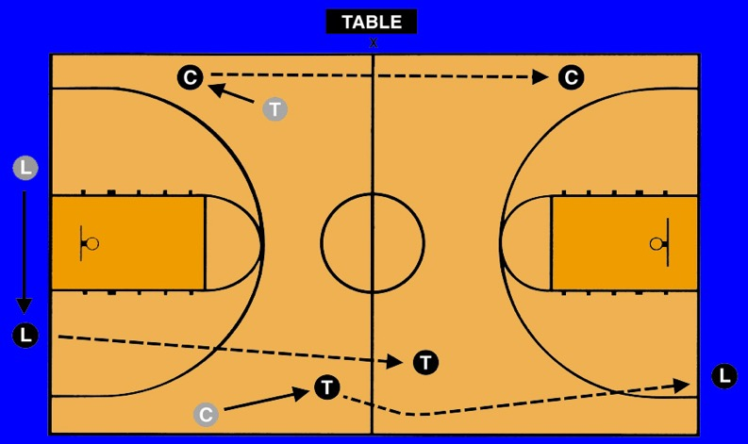
Transition Coverage After Rotation
Notes:
Transition Coverage After Rotation

Slide 40
Throw-In Cues
L may administer throw-ins on either side of player when staying in frontcourt; T mirrors clock-chop signal.
T handles all throw-ins in the backcourt – regardless of location – “bump and run” if necessary.
T may bounce any sideline or end line throw-in (depends on defensive pressure).
Notes:
Throw-In Cues:
- L may administer throw-ins on either side of player when staying in frontcourt; T mirrors clock-chop signal.
- T handles all throw-ins in the backcourt – regardless of location – “bump and run” if necessary.
- T may bounce any sideline or end line throw-in (depends on defensive pressure)
.

Slide 41
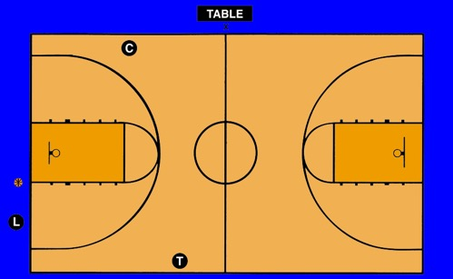
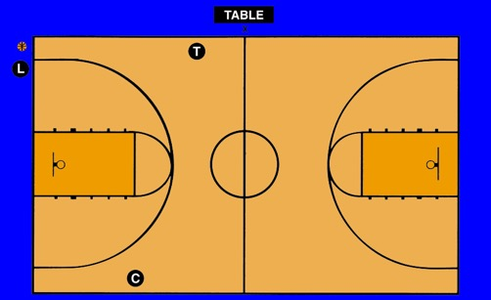
End Line Throw-Ins in the Frontcourt
L may administer throw-ins on either side of player when staying in frontcourt; T mirrors chop-clock signal
Notes:
End Line Throw-Ins in the Frontcourt:
- The Lead administers all throw-ins on the end line in the frontcourt
- The Lead may administer throw-ins on either side of player when staying in frontcourt. The position chosen should give the Lead the best possible angle to officiate the play.
- Trail mirrors the Lead’s chop clock signal.

Slide 42
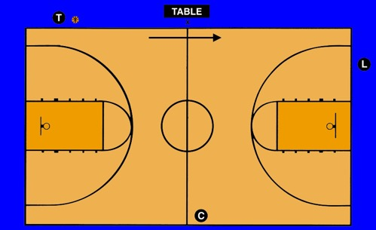
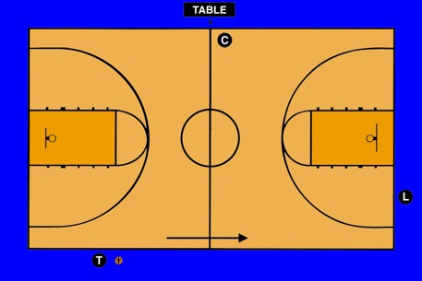
Sideline Throw-Ins in the Backcourt
T handles all throw-ins in the backcourt – regardless of location – “bump and run” if necessary
Notes:
Sideline Throw-Ins in the Backcourt:
A. Trail handles all throw-ins in the backcourt, regardless of location (“bump and run,” if necessary).
B. Trail may bounce any sideline or end line throw-in (may depend on defensive pressure).
C. If no pressure, Center and Lead may go to “home” positions.

Slide 43
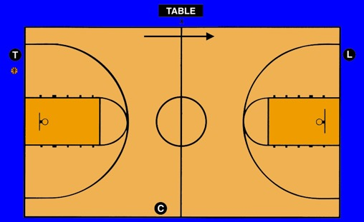
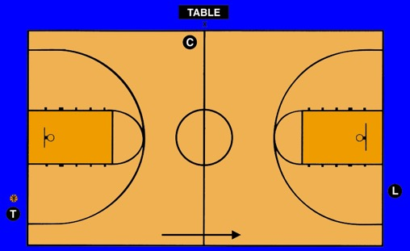
End Line Throw-Ins in the Backcourt
If no pressure, C and L may go to home locations
Notes:
End Line Throw-ins in the Backcourt:
A. Trail handles all throw-ins in the backcourt, regardless of location (“bump and run,” if necessary).
B. Trail may bounce any sideline or end line throw-in (may depend on defensive pressure).
C. If no pressure, Center and Lead may go to “home” positions.

Slide 44
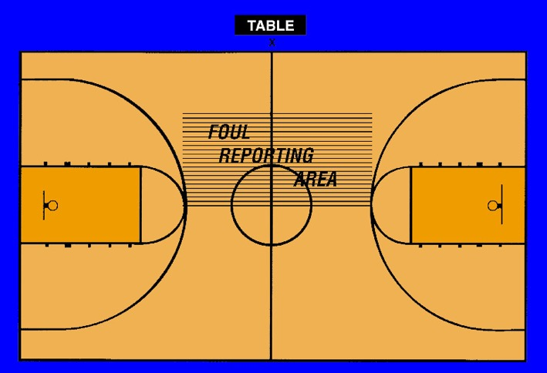
Foul Reporting
Notes:
Foul Reporting:
The official calling the foul should go to the spot within the reporting area that will facilitate the quickest movement to the next position. For instance, when the L calls an offensive foul and play is “going long” the throw-in will be on the end line, the official should go to the reporting area to report and then switch with trail or center depending on whether the call was table side or opposite.

Slide 45
Fouls & Basic Switching
Non-calling officials should observe all players.
Calling official goes table side after reporting.
Official originally table side fills the vacancy left by the calling official.
Notes:
Fouls & Basic Switching:
- Non-calling officials should observe all players.
- Calling official goes table side after reporting.
- Official originally table side fills the vacancy left by the calling official.

Slide 46
Fouls & Basic Switching
Third official remains in same position occupied at time of foul.
If calling official was table side, no switch occurs.
Notes:
Fouls & Basic Switching:
- Third official remains in same position occupied at time of foul
- If calling official was table side, no switch occurs

Slide 47
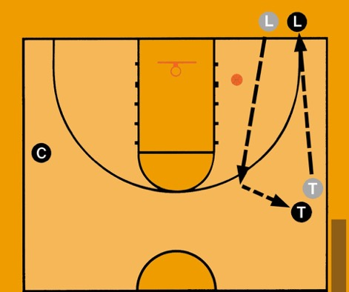
Foul Reporting & Switching
Staying in the Frontcourt
Lead calls tableside foul goes to reporting area.
L becomes new T
T becomes new L.
C remains C.
Notes:
Foul Reporting and Switching: Staying in the Frontcourt
- Lead calls tableside foul – goes to reporting area. Becomes new T
- T becomes new L
- C remains C
Important for all officials to designate throw-in spot.

Slide 48
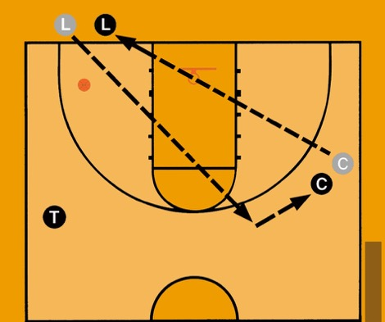
Foul Reporting & Switching
Lead calls foul opposite table, goes to reporting area.
L becomes new C
C becomes new L
T remains T
Staying in the Frontcourt
Notes:
Foul Reporting and Switching: Staying in the Frontcourt
- Lead calls foul opposite table goes to reporting area. Then becomes new C.
- C becomes new L
- T remains T

Slide 49
Foul Reporting & Switching on Offensive Calls
Backcourt to Frontcourt -No Free Throws
L calls foul opposite, reports and moves to front court to become the new C.
Old T becomes
new L.
C becomes the new T and administers the throw-in.
Notes:
Foul Reporting and Switching on Offensive Calls: Backcourt to Frontcourt – No Free throws
Table Side:
- L calls foul table side, reports and becomes the new L
- Old C becomes the new C
- Old T becomes the new T and administers the throw-in
Opposite:
- L calls foul opposite, reports and moves to front court to become the new C
- Old T becomes new L
- Old C becomes the new T and administers the throw-in

Slide 50
Foul Reporting & Switching on Offensive Calls
Backcourt to Frontcourt - No Free Throws
T calls foul opposite, reports and moves opposite to become new L.
Old C becomes new C.
L goes to sideline to administer throw-in and becomes new T.
Notes:
Foul Switching and Switching on Offensive Calls: Backcourt to Frontcourt – No Free Throws
Table Side:
- T calls foul, reports and slides down to become new L
- Old C becomes new C
- Old L becomes the T and goes to the sideline to administer the throw-in
Opposite:
- T calls foul, reports and moves opposite to become new L
- Old C becomes new C
- L goes to sideline to administer throw-in and becomes new T

Slide 51
Foul Reporting & Switching on Offensive Calls
Backcourt to Frontcourt - No Free Throws
C calls tableside, reports and slides down to become new L.
Old T becomes new C.
L goes to sideline to administer throw-in and
becomes new T.
Notes:
Foul Reporting and Switching on Offensive Calls: Backcourt to Frontcourt – No Free Throws
Table Side:
- C calls foul, reports and slides down to become new L
- Old T becomes new C
- Old L becomes the T and goes to the sideline to administer the throw-in
Opposite:
- C calls foul, reports and moves opposite to become new L
- Old T becomes new C
- L goes to sideline to administer throw-in and becomes new T

Slide 52
Disqualification Procedure
New table side (C or T) official:
  Notifies coach,
  Requests timer to begin 20-second replacement interval,
  Notifies disqualified player.
Officials not administering disqualification position for subsequent throw-in or free throw.
Notes:
Disqualification Procedure:
New table side (C or T) official:
Notifies coach
Requests timer to begin 20-second replacement interval
Notifies disqualified player
Officials not administering disqualification position for subsequent throw-in or free throw

Slide 53
Disqualification Procedure
Administering official takes a position on division line halfway between center circle and sideline nearest table to administer substitution.
Notes:
Disqualification Procedure:
Administering official takes a position on division line halfway between center circle and sideline nearest table to administer substitution.

Slide 54
Free Throws
Calling official becomes T – observes all action and assists with violations, rebounding action and fouls.
L administers all free throws – has responsibility for bottom lane space and three spaces on the opposite line.
C has responsibility for shooter, flight of ball, and top two lane spaces on opposite line.
C and T close down on last shot attempt.
Notes:
Free Throws:
- Calling official becomes T – observes all action and assists with violations, rebounding action and fouls.
- L administers all free throws – has responsibility for bottom lane space and three spaces on the opposite line.
- C has responsibility for shooter, flight of ball, and top two lane spaces on opposite line.
- C and T close down on last shot attempt.

Slide 55
Free Throws
T is at approximately the 28-foot mark and just inside the tableside boundary line – NOT at the division line.
L is approximately 4 feet from near lane line for ALL free throws.
C is halfway between the near lane line and the sideline; just above the free-throw line extended.
Notes:
Free Throws:
- T is at approximately the 28-foot mark and just inside the tableside boundary line – NOT at the division line.
- L is approximately 4 feet from near lane line for ALL free throws.
- C is halfway between the near lane line and the sideline; just above the free-throw line extended.

Slide 56
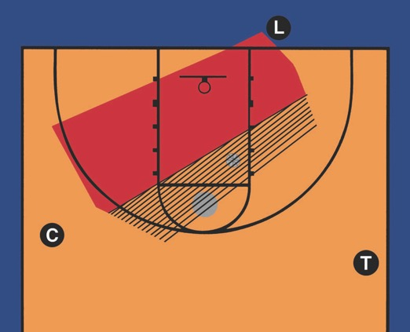
Free Throws
Calling official becomes T
L administers all throws
C and T close down on last shot attempt
Notes:
Free Throws:
- Calling official becomes T
- L administers all throws
- C and T close down on last shot attempt

Slide 57
Time-Outs & Intermissions
Administering official stays with ball at resumption of play location – puts ball on floor if movement is necessary.
Positioning of two free officials:
  60-second time-out/intermission – nearest block
  30-second time-out – top of three-point arc
Officials should observe bench and table activity.
Notes:
Time-Outs & Intermissions:
- Administering official stays with ball at resumption of play location – puts ball on floor if movement is necessary.
- Positioning of two free officials:
- 60-second time-out/intermission – nearest block
- 30-second time-out – top of three-point arc
- Officials should observe bench and table activity.

Slide 58
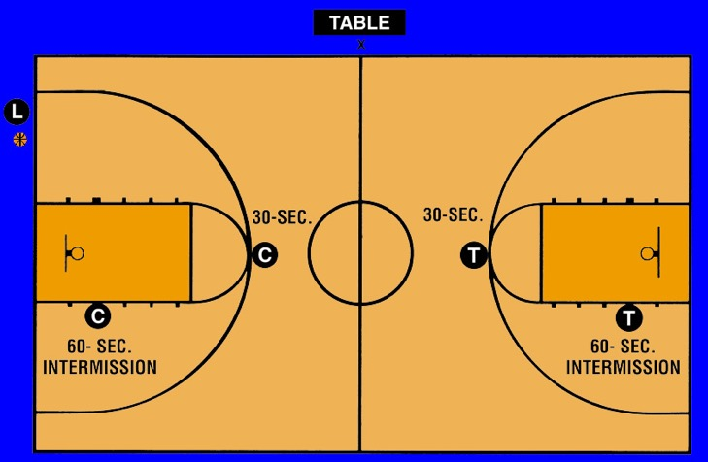
Time-outs & Intermissions
Notes:
Time-outs and Intermissions

Slide 59
Last-Second Shot
C or T – Opposite table official is responsible.
L may offer assistance or be responsible on fast break.
Responsible official communicates with partners that they have the last-second shot.
Discuss during pregame.
Notes:
Last-Second Shot:
- C or T – Opposite table official is responsible
- L may offer assistance or be responsible on fast break
- Responsible official communicates with partners that they have the last-second shot
- Discuss during pregame

Slide 60
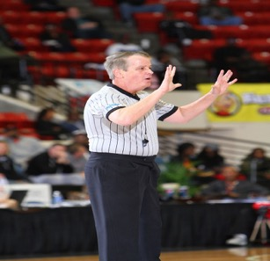
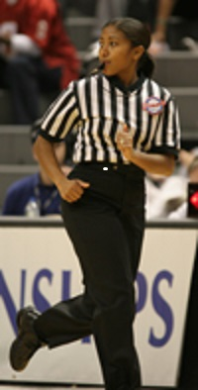
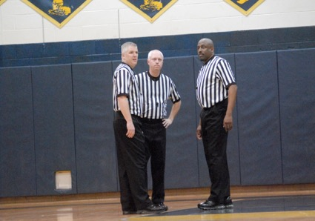
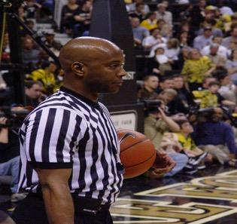
Thank you!
www.nfhs.org
Notes:
Thank you

